Slide 1


Slide 2

Welcome to CollabDays Oslo!

Slide 3












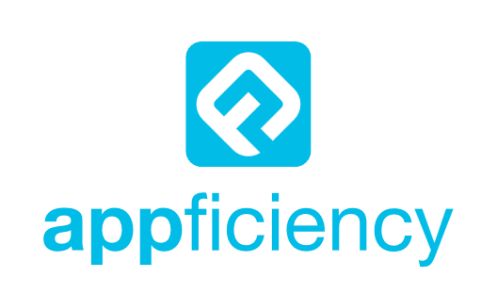




Slide 4







About Me
Modern Workplace Architect @ Arxus
Tech Blogger @ https://Cloudflow.be
Creator of Intune-Toolkit
Belgium Ski Instructor
Avid Scuba Diver

Slide 5
Agenda
Intune Advanced Analytics Overview
Demo’s
Copilot For Intune Overview
Demo’s

Slide 6
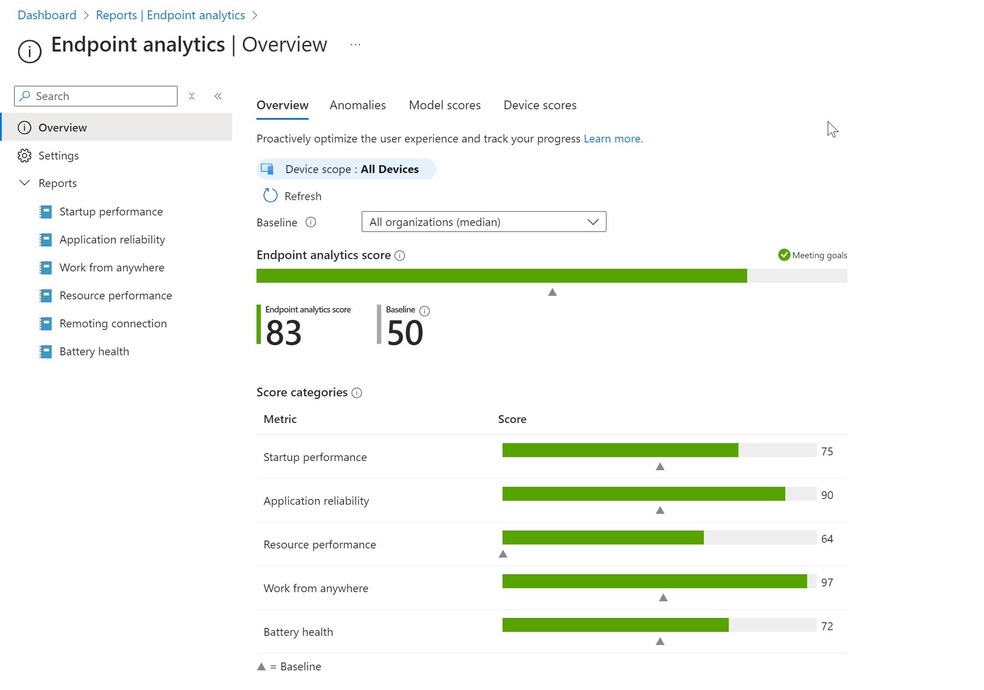
Intune Advanced Analytics
Device Scopes
Battery Health Report
Recourse performance Report
Enhanced Device Timeline
Anomoly Detection
Device Query

Slide 7
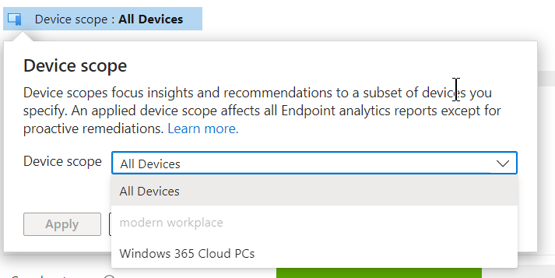
Device Scopes
Customized Reporting for Specific Device Groups:
Focused Insights and Recommendations:
Enhanced Management Efficiency:
Improved Security and Compliance:
Notes:
Customized Reporting for Specific Device Groups:
Advantage: Device scopes allow you to filter Endpoint Analytics reports to focus on specific subsets of devices using Scope tags. This enables you to analyze performance and compliance metrics for particular departments, locations, or roles within your organization.
Focused Insights and Recommendations:
Advantage: By applying device scopes, you receive scores, insights, and recommendations tailored to the selected group of devices. This targeted approach helps in identifying and addressing issues more effectively within specific segments of your device fleet.
Enhanced Management Efficiency:
Advantage: Device scopes streamline management tasks by allowing IT administrators to concentrate on the devices they are responsible for. This reduces complexity and saves time when monitoring and troubleshooting.
Improved Security and Compliance:
Advantage: Since device scopes leverage Intune Scope tags, they align with your organization's role-based access controls. This ensures that administrators only access data relevant to their permissions, maintaining security and compliance standards.

Slide 8
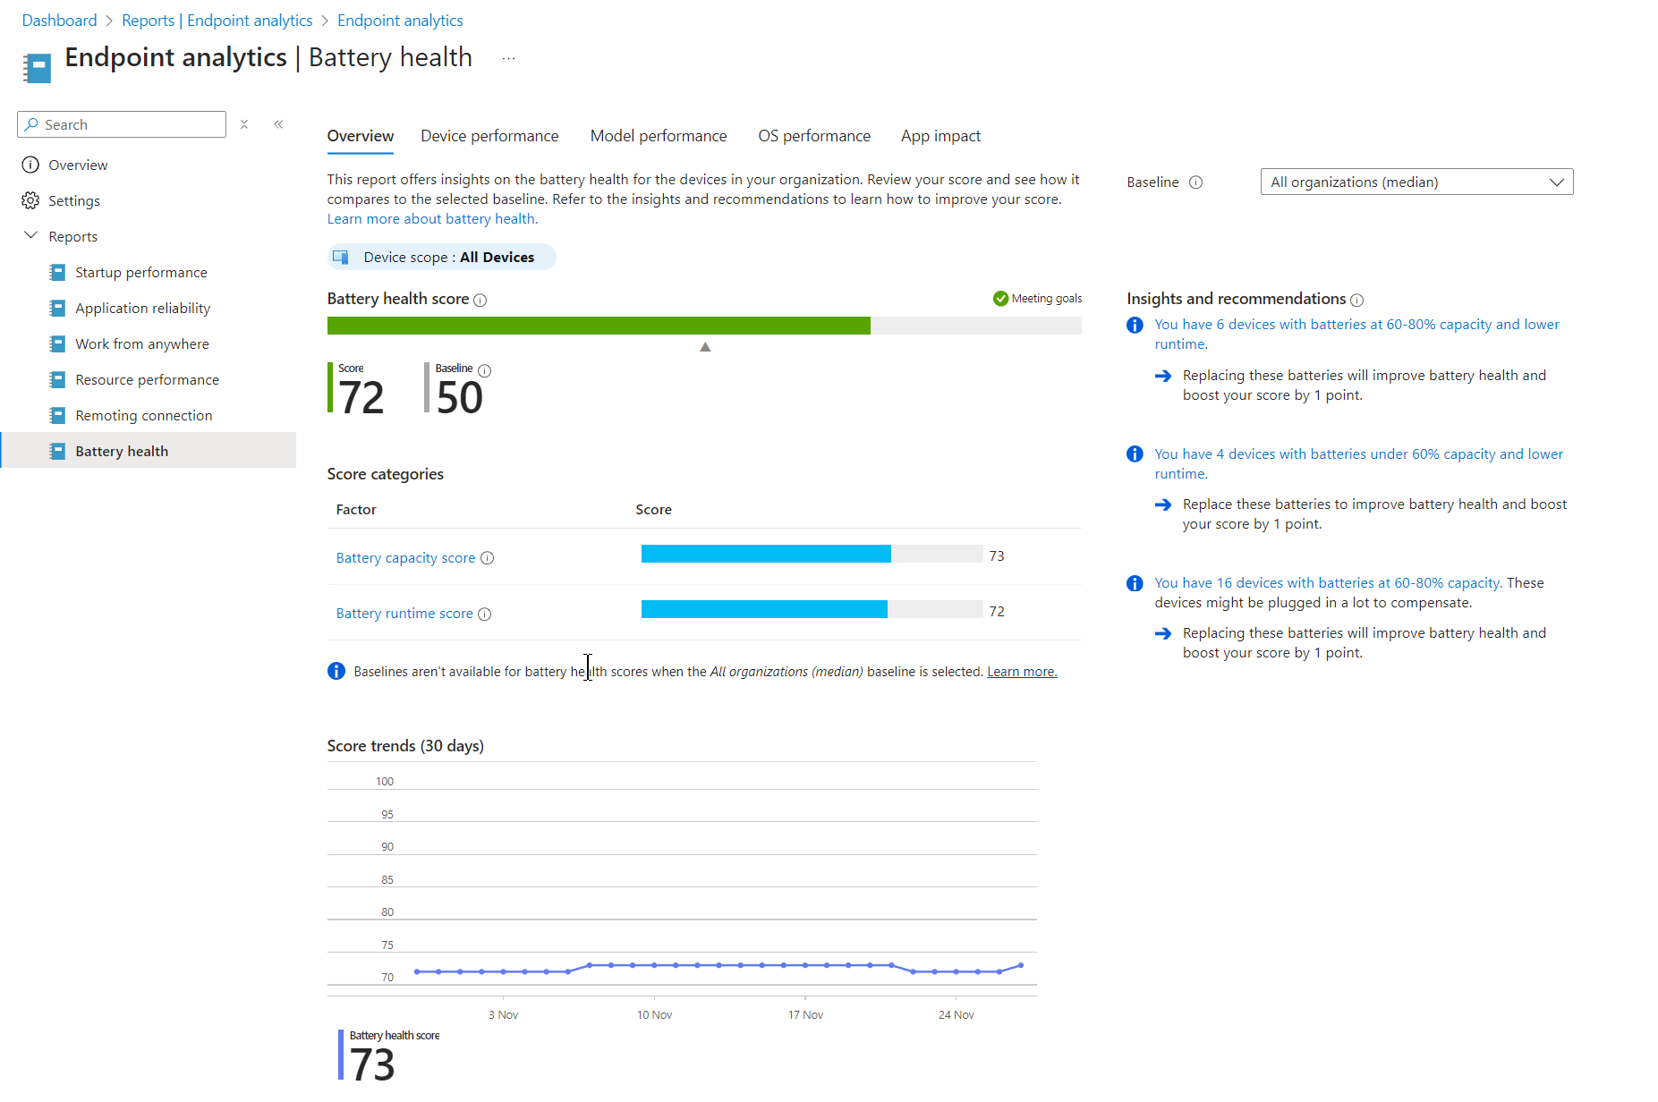
Battery Health Report
Easily Check How Your Device Batteries Are Doing
Find Battery Problems Before They Cause Trouble
Keep Your Team Working Smoothly
Save Money by Using Warranties Wisely
Make Smart Choices Using Real Data
Notes:
Easily Check How Your Device Batteries Are Doing
Benefit: You can see the health of all the batteries in your organization's devices at a glance. This helps you know which batteries are still strong and which ones might need attention.
Find Battery Problems Before They Cause Trouble
Benefit: The report helps you spot battery issues early on, so you can fix or replace them before they affect your users. This means fewer unexpected shutdowns and complaints.
Keep Your Team Working Smoothly
Benefit: By making sure device batteries are in good shape, your team can work longer without needing to plug in all the time. This improves their experience and helps them stay productive.
Save Money by Using Warranties Wisely
Benefit: You'll know which batteries are failing faster than they should. This lets you replace them under warranty before it expires, saving your organization money.
Make Smart Choices Using Real Data
Benefit: With clear information about battery performance, you can make informed decisions about device upkeep and policies. This leads to better planning and fewer surprises down the line.

Slide 9

Battery Health Graph Api
https://graph.microsoft.com/beta/deviceManagement/userExperienceAnalyticsBatteryHealthDevicePerformance
https://graph.microsoft.com/beta/deviceManagement/userExperienceAnalyticsBatteryHealthModelPerformance
https://graph.microsoft.com/beta/deviceManagement/userExperienceAnalyticsBatteryHealthOsPerformance
https://graph.microsoft.com/beta/deviceManagement/userExperienceAnalyticsBatteryHealthAppImpact
Notes:
Comprehensive Visibility into Battery Health:
Advantage: The Battery Health Report provides detailed insights into the health of batteries across your organization's devices. It helps you monitor battery capacities and estimated runtimes, giving you a clear view of how battery performance affects user experience.
Proactive Identification of Hardware Issues:
Advantage: By identifying devices with declining battery capacities or low estimated runtimes, you can proactively address hardware issues before they impact user productivity. This means replacing failing batteries before users experience significant downtime or generate support tickets.
Optimized User Experience and Productivity:
Advantage: The report highlights how battery health influences user experience, allowing you to take steps to improve it. By ensuring devices have healthy batteries, users can work longer without needing to plug in frequently, enhancing mobility and productivity.
Cost Savings through Warranty Management:
Advantage: The insights help you identify batteries that are failing quickly, enabling you to replace them under warranty before it expires. This not only saves costs but also extends the life of your devices by ensuring they operate efficiently.
Data-Driven Decision Making:
Advantage: With detailed metrics on battery performance, you can make informed decisions about device procurement, maintenance, and policy adjustments. The report aids in understanding trends and patterns, such as the impact of specific apps on battery drain, leading to more effective IT strategies.

Slide 10
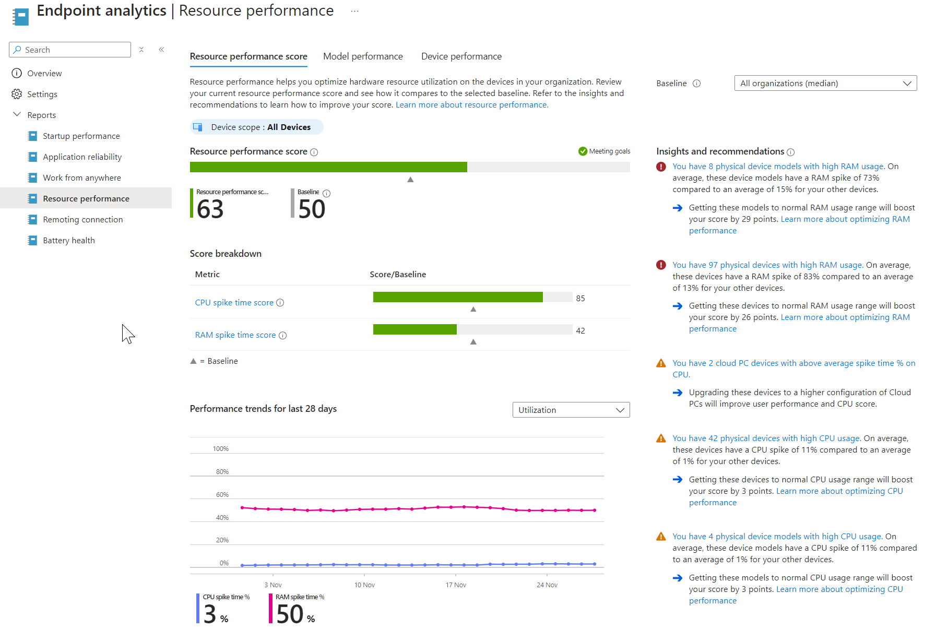
Resource Performance
Monitor Device Health Proactively
Anticipate and Resolve Performance Issues Early
Enhance User Experience and Efficiency
Optimize Hardware Upgrades and Budgeting
Notes:
Monitor Device Health Proactively:
Benefit: The Resource Performance Report functions like a health dashboard for your devices' CPUs and RAM. It enables you to quickly identify which systems are running optimally and which ones are under strain, so you can address issues before they impact user productivity.
Anticipate and Resolve Performance Issues Early:
Benefit: By keeping an eye on CPU and RAM spikes, you can spot devices that are likely to experience slowdowns or crashes. This proactive approach allows you to troubleshoot or upgrade hardware before performance issues affect your team.
Enhance User Experience and Efficiency:
Benefit: Ensuring devices have sufficient processing power and memory helps your users work seamlessly without frustrating delays. This leads to increased efficiency and a better overall user experience.
Optimize Hardware Upgrades and Budgeting:
Benefit: The report provides data to help you decide when it's time to upgrade or replace hardware. You can identify underperforming devices and take advantage of warranties or plan for replacements, ensuring wise investment of your IT budget.

Slide 11
Resource Performance Graph Api
https://graph.microsoft.com/beta/deviceManagement/userExperienceAnalyticsResourcePerformance
https://graph.microsoft.com/beta/deviceManagement/userExperienceAnalyticsResourcePerformance/summarizeDeviceResourcePerformance(summarizeBy='parameterValue’)

Slide 12
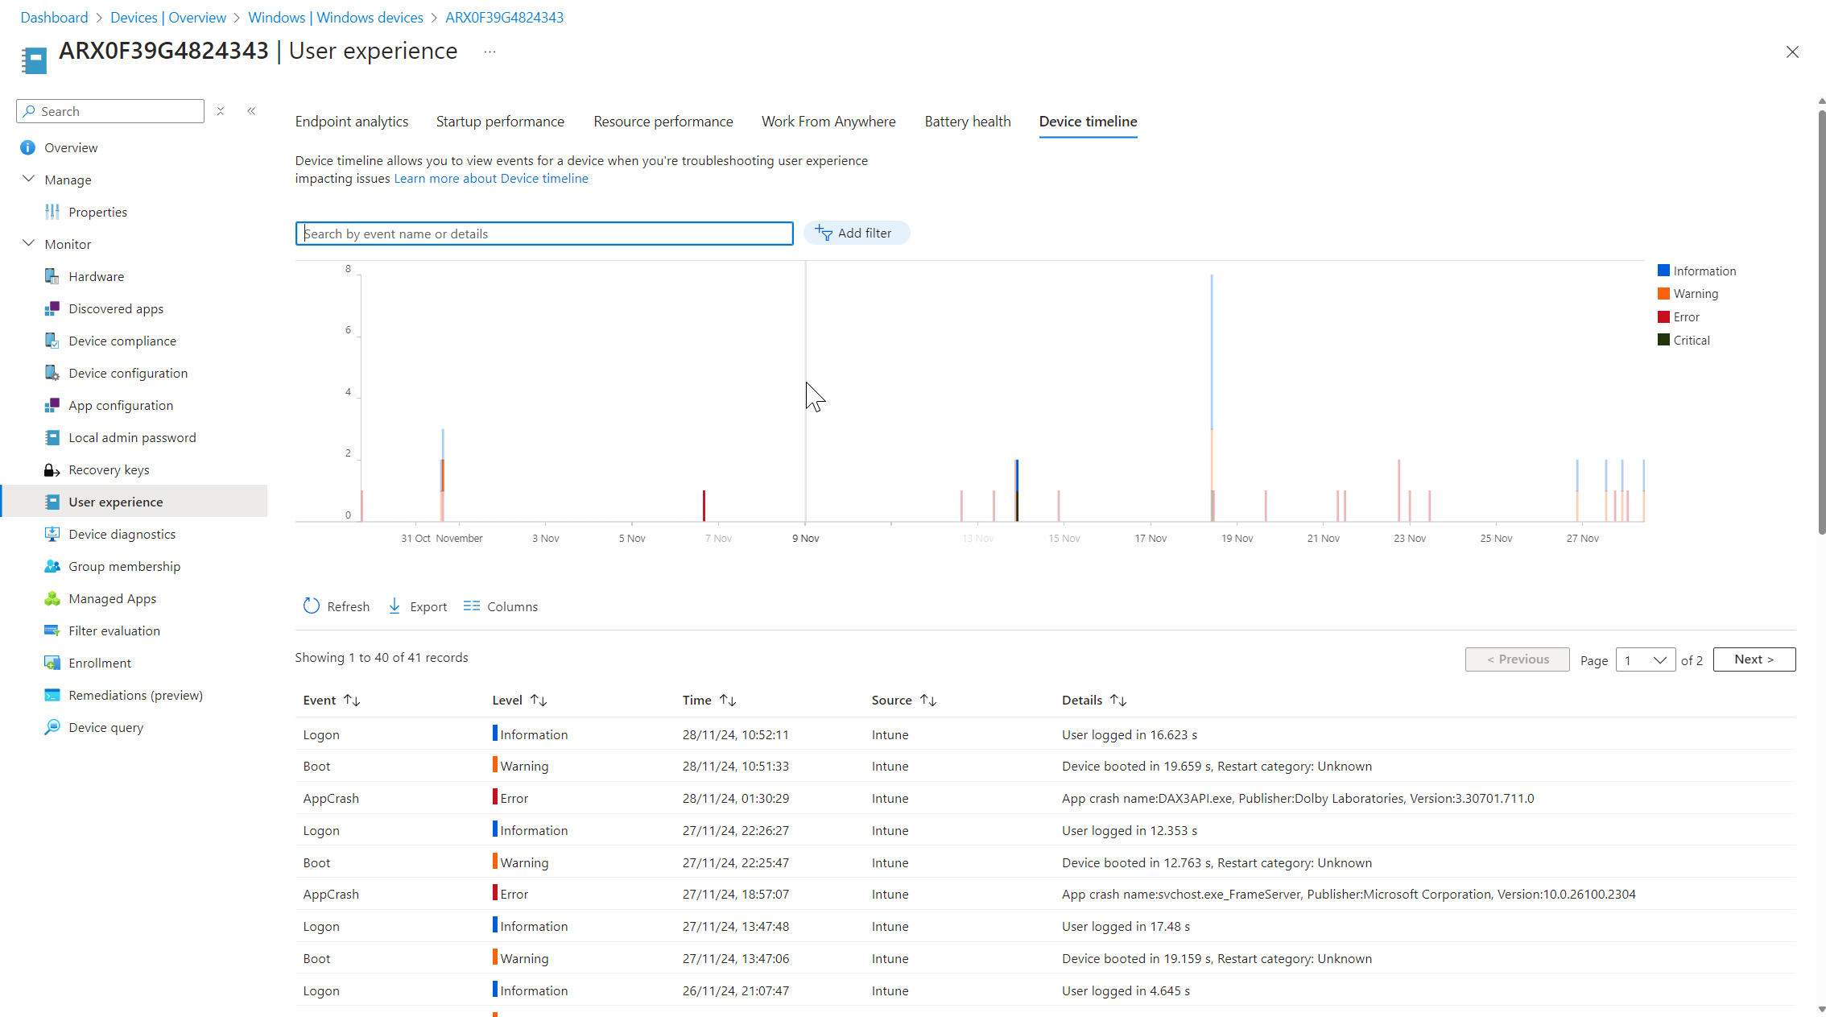
Enhanced Device Timeline
Comprehensive Event History for Devices
Streamlined Troubleshooting Process
Customizable Filters for Targeted Insights
Notes:
Comprehensive Event History for Devices:
Benefit: The Enhanced Device Timeline gives you a detailed history of significant events on a specific device, such as app crashes, unresponsive apps, device boots, logons, and detected anomalies. This centralized view helps you understand the device's behavior over time without digging through multiple logs.
Streamlined Troubleshooting Process:
Benefit: By having all relevant events in one timeline, you can quickly diagnose and resolve issues. This saves you time and effort, allowing you to focus on fixing problems rather than finding them.
Customizable Filters for Targeted Insights:
Benefit: You can filter events by type, source, severity level, and specific time ranges. This flexibility lets you zero in on particular issues or patterns, making it easier to identify the root cause of problems.

Slide 13
Enhanced Device Timeline Graph Api
https://graph.microsoft.com/beta/deviceManagement/userExperienceAnalyticsDeviceTimelineEvent/{userExperienceAnalyticsDeviceTimelineEventId}

Slide 14
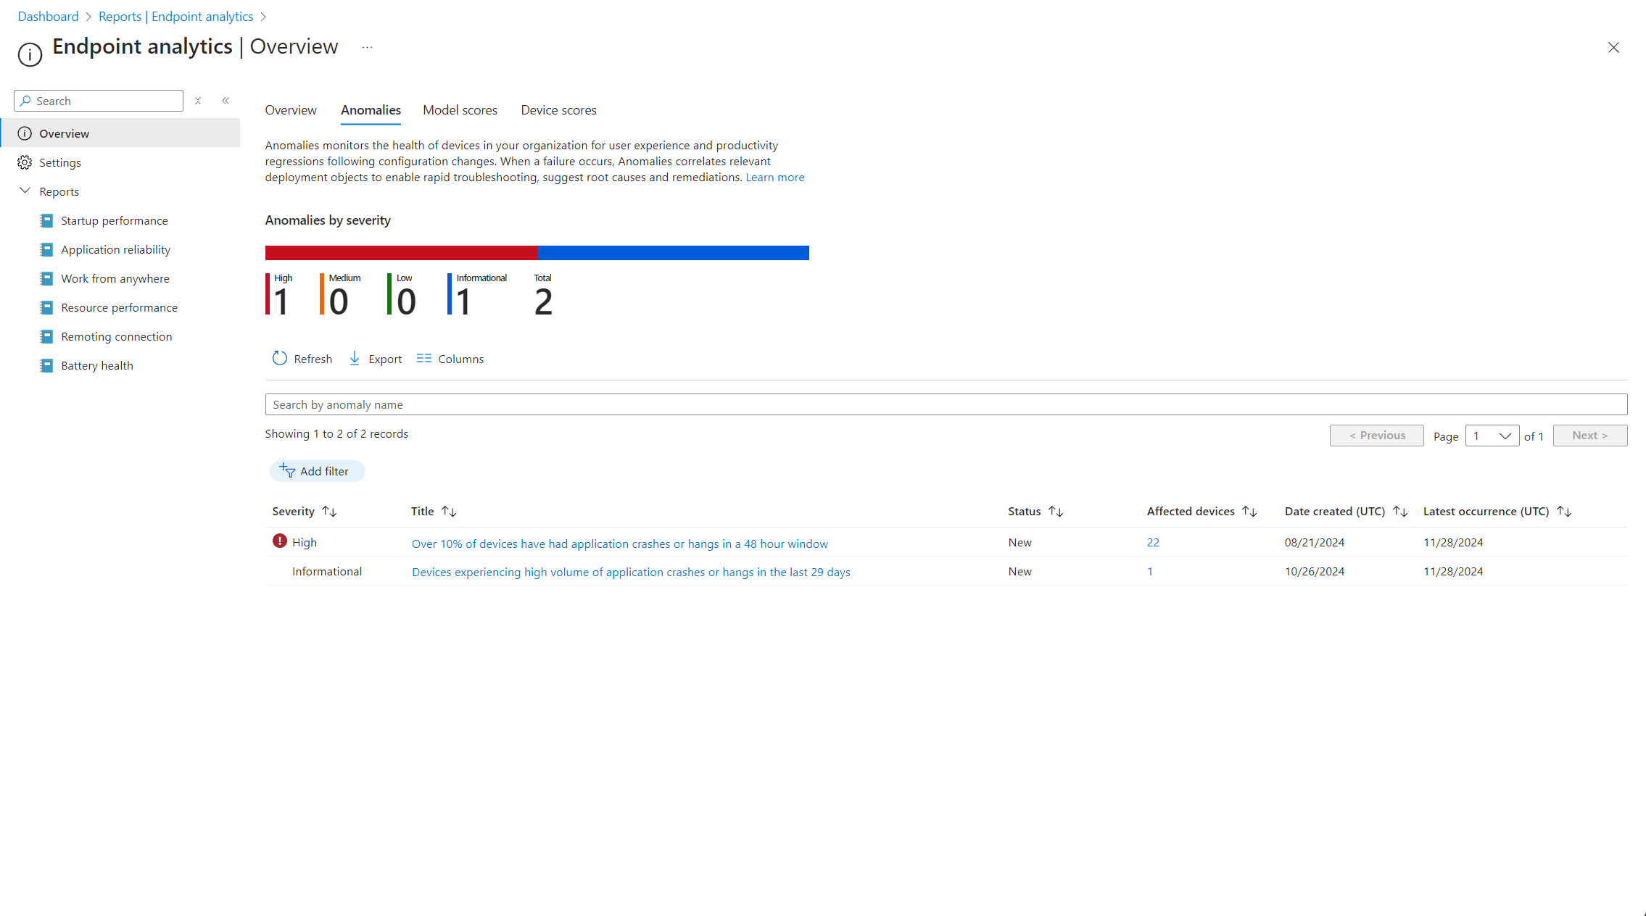
Anomaly Detection
Early Warning System for Device Issues
Proactive Identification of User Experience Regressions
Correlated Insights for Rapid Troubleshooting
Device Cohorts and At-Risk Identification
Notes:
Early Warning System for Device Issues:
Benefit: Anomaly Detection acts like an alert system that monitors your organization's devices for unusual patterns, such as spikes in app crashes or system errors. This helps you catch potential problems before they escalate and affect more users.
Proactive Identification of User Experience Regressions:
Benefit: It keeps an eye on how configuration changes impact device performance and user productivity. By spotting negative effects early, you can address them promptly rather than waiting for support tickets to pile up.
Correlated Insights for Rapid Troubleshooting:
Benefit: The system correlates anomalies with relevant factors like app versions, OS updates, or device models. This grouping helps you pinpoint root causes faster, making troubleshooting more efficient.
Device Cohorts and At-Risk Identification:
Benefit: Anomaly Detection identifies groups of devices experiencing similar issues and highlights other devices at risk. This allows you to take targeted action to prevent problems from spreading, enhancing overall device health.

Slide 15
Anomaly Detection Graph Api
https://graph.microsoft.com/beta/deviceManagement/userExperienceAnalyticsAnomaly
Notes:
Comprehensive Visibility into Battery Health:
Advantage: The Battery Health Report provides detailed insights into the health of batteries across your organization's devices. It helps you monitor battery capacities and estimated runtimes, giving you a clear view of how battery performance affects user experience.
Proactive Identification of Hardware Issues:
Advantage: By identifying devices with declining battery capacities or low estimated runtimes, you can proactively address hardware issues before they impact user productivity. This means replacing failing batteries before users experience significant downtime or generate support tickets.
Optimized User Experience and Productivity:
Advantage: The report highlights how battery health influences user experience, allowing you to take steps to improve it. By ensuring devices have healthy batteries, users can work longer without needing to plug in frequently, enhancing mobility and productivity.
Cost Savings through Warranty Management:
Advantage: The insights help you identify batteries that are failing quickly, enabling you to replace them under warranty before it expires. This not only saves costs but also extends the life of your devices by ensuring they operate efficiently.
Data-Driven Decision Making:
Advantage: With detailed metrics on battery performance, you can make informed decisions about device procurement, maintenance, and policy adjustments. The report aids in understanding trends and patterns, such as the impact of specific apps on battery drain, leading to more effective IT strategies.

Slide 16
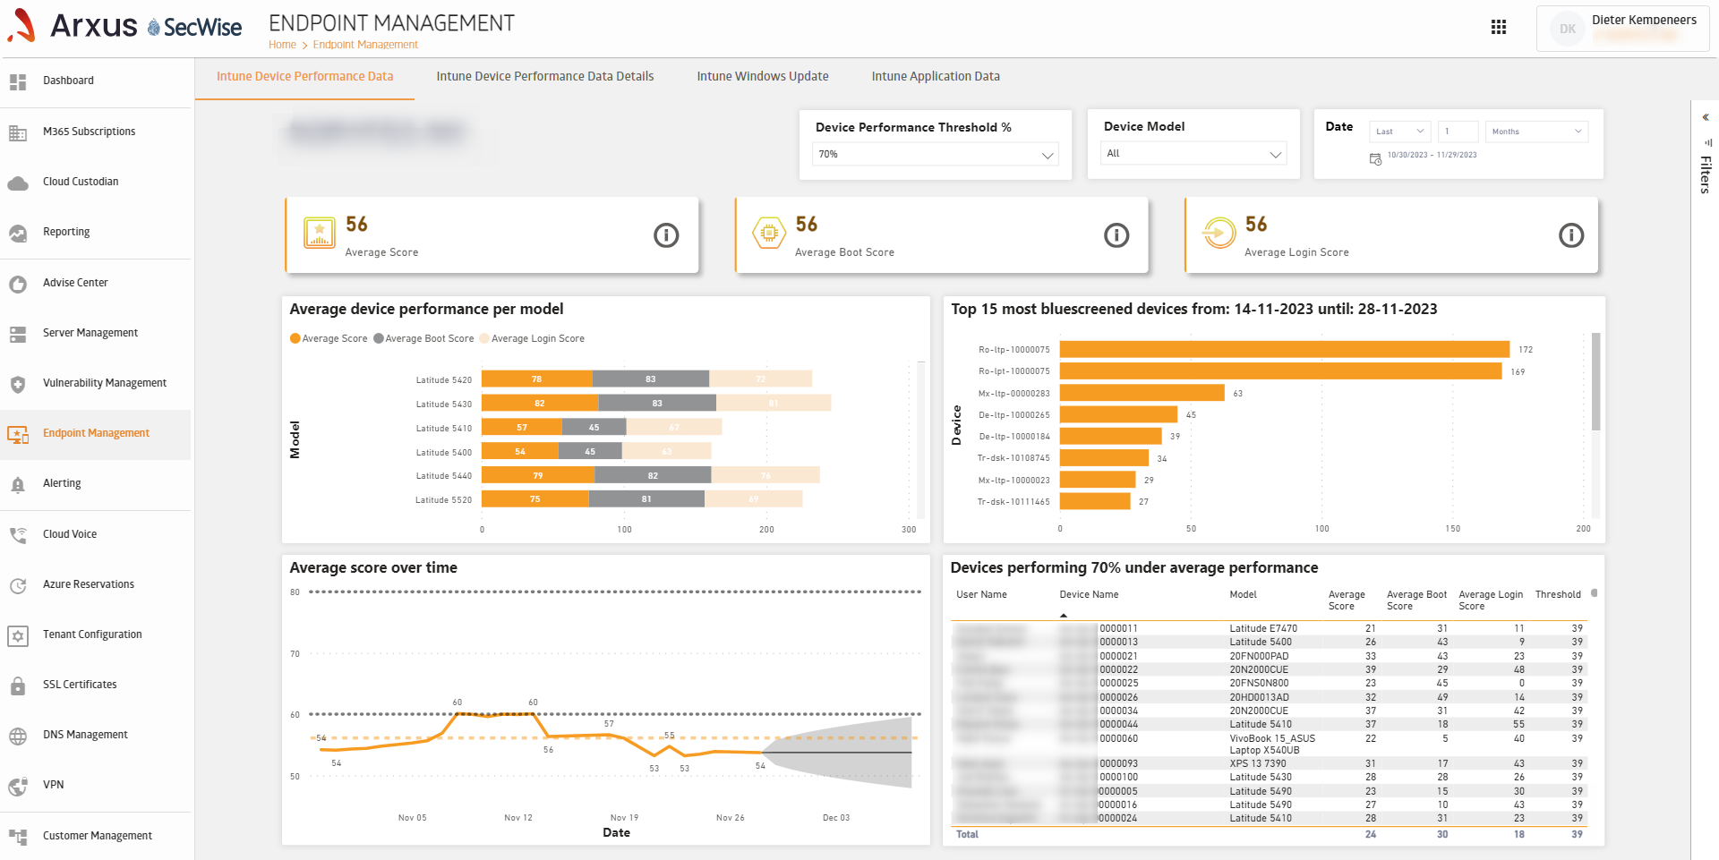
Create Your own Reports

Slide 17
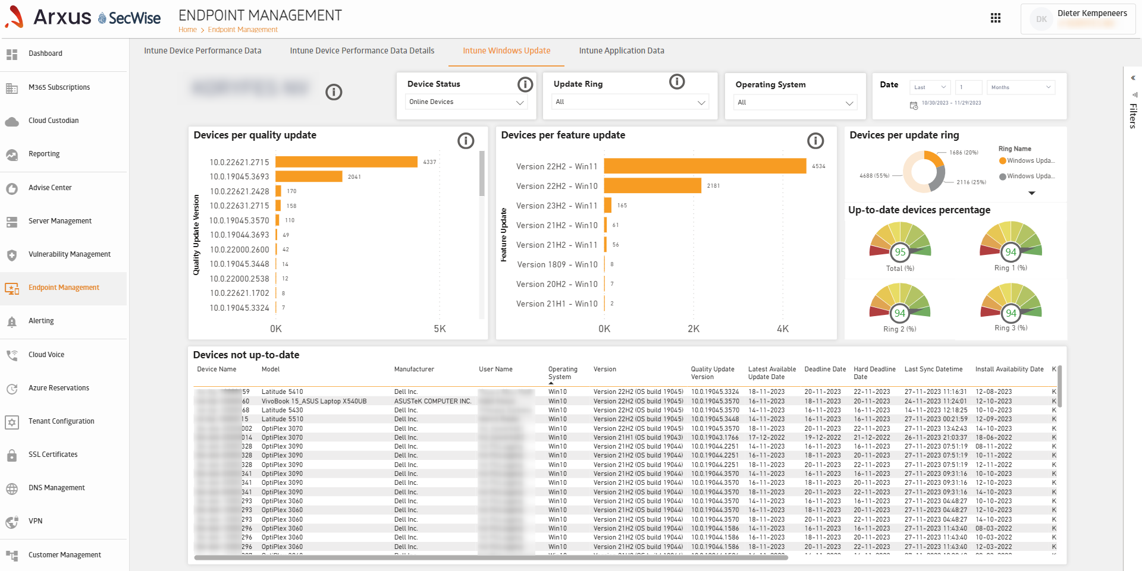
Create Your own Reports

Slide 18
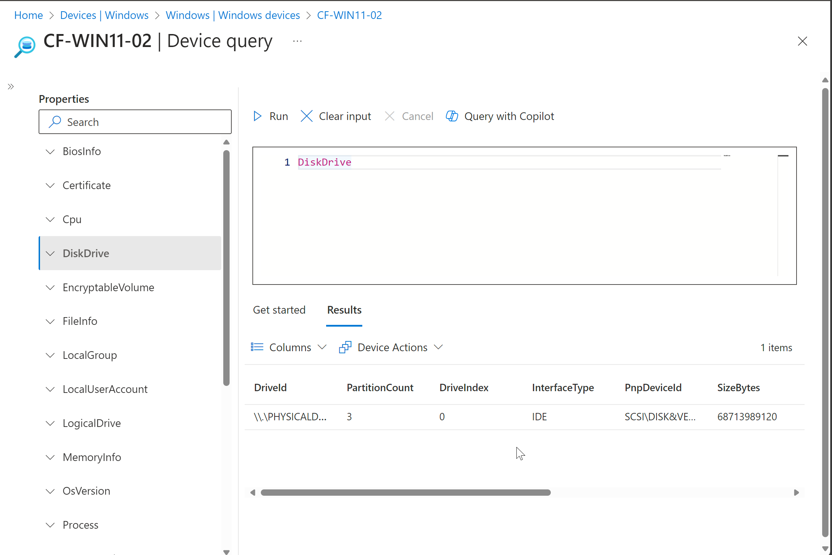
Device Query
Real-Time Device Information Retrieval
Powerful Troubleshooting with KQL Integration
Remote Actions from a Single Interface
Enhanced Security and Compliance Monitoring
Notes:
Real-Time Device Information Retrieval:
Benefit: Device Query allows you to run real-time queries on specific devices to gather immediate information about their current state. This helps you quickly respond to security threats, troubleshoot issues, or make informed business decisions without waiting for scheduled reports.
Powerful Troubleshooting with KQL Integration:
Benefit: By leveraging Kusto Query Language (KQL), you can craft detailed queries to extract specific data from a device. This flexibility enables deep dives into device configurations, installed applications, running processes, and more, facilitating efficient problem-solving.
Remote Actions from a Single Interface:
Benefit: Device Query integrates with Intune's remote device actions, allowing you to execute tasks like restarting a device, collecting diagnostics, or initiating a malware scan directly from the query interface. This streamlines the remediation process by reducing the steps needed to address issues.
Enhanced Security and Compliance Monitoring:
Benefit: With Device Query, you can quickly check compliance statuses, verify encryption settings, or confirm security updates on devices. Immediate access to this information helps maintain your organization's security posture and ensures devices meet compliance requirements.

Slide 19
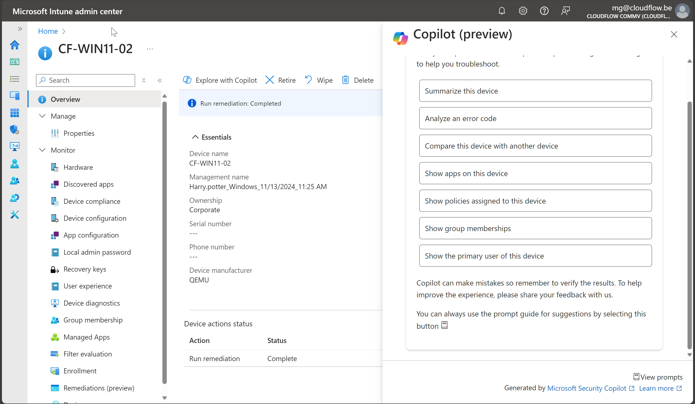
Microsoft Copilot + Intune
Learn more about individual settings and recommended values
Summarize an existing policy
Get device details and troubleshoot a device
Query with Copilot in device query

Slide 20







Get in Touch
mg@cloudflow.be

Slide 21

Have a Great Day

